Slide 1
VAST Challenge 2018 MC-2
Team Members
Hemanth Sai Kumar Challapalli
Kavitha Padala
Akshat Satishkumar Patel
Maharshi Nimeshkumar Raval
Chitralekha Kalavala

Slide 2
Our Work
Data Cleaning
Gathering Information and Learning on D3
Coding
PPT
Everyone were part of all the works and contributed equally in all the tasks.

Slide 3
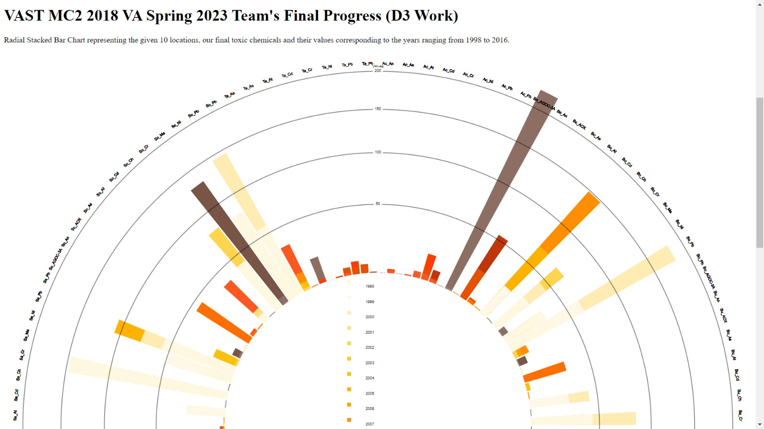

Slide 4
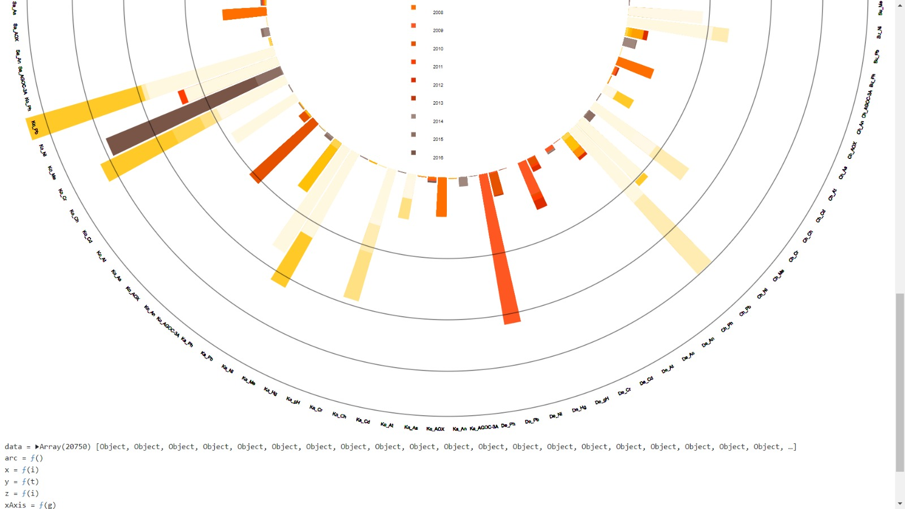

Slide 5
Progress
Sun inspired chart.
Data used: 10 locations, 12 toxic chemicals and 18 years ranging from 1998 to 2016.
Interaction and rotational features added.
For better visualization, we’ve represented the different locations and chemicals in a short format as “Location_ChemicalName”. E.g.: “So_Pb” implies the value of Lead in Somchair.
Link to our D3: http://127.0.0.1:8080/

Slide 6
Any Questions?

